Slide 1
Journey analytics for user drop outs

Slide 2
Increase lead conversion rates with Journey analytics
Challenge
Increasing lead conversion rates
Continuous improvement activity not one time
Solution
Identify P1 reasons for dropouts, make changes and release every day
How
Insights into drop outs
Identify P1 issues resulting into drop outs
Flexibility to change journey
1 hour roll out capability
KPIs
Increase lead /conversion rates by 30% every month for 3 months
Reduce time to analyze to <3 hours
Currently - Idea to Production – 4 Wks
Bi-Weekly Releases
Business Ops – System SLA Monitoring only
Weekly User Journey Analysis <–> Paralysis
Action - Idea to Production – 1 Day
Daily release possible
Business Ops – Goal KPI Monitoring
Hourly User Journey Analysis – Automation
Weekly report by Bus. Ops team
Telco analysis – 1 weeks
Development Sprint
Roll out – bi-weekly
Reports every hour
Identify P1 issues affecting goals
Changes in existing sprint
1 hour roll out capability

Slide 3
MVPs – Journey analytics
 |  |  |  | Time | Filters
MVP 1 | Business Dashboard | Business KPIs | View into business run rate and trends KPIs - lead, order, deliveries, activations | Daily - Manual | Date / Duration, Circle, Source channel, Journey intent
 |  | Journey Performance | Visibility into buying behavior and drop outs KPIs – Visits, Conversions and Drop outs on journey pages
 |  | Order to Activation | Stage-wise visibility from order to activation KPIs – Order count per stage |  | Date / Duration, Circle, Source channel, Journey intent, Fulfilment Partner
 | Delivery Dashboard | Order to Activation | Stage-wise visibility from order to activation KPIs – Order count per stage, avg. time
MVP 2 | Business & Delivery Dashboard | Business KPIs Journey Performance Order to Activation | Same as above | Automated – Daily | Same as above
MVP 3 | Business & Delivery Dashboard | Business KPIs Journey Performance Order to Activation | Same as above | Real time | Same as above
MVP 4 | Business Dashboard | Drop out analysis | Visibility into drop outs at field level per page & order to activation
MVP 5 | Business Dashboard | UX /UI | Revamp experience; drill downs
MVP 5 | Business Dashboard | Drop out analysis | Capture and analyze customer feedback
MVP 6 | Business Dashboard | Drop out analysis | Insights using ML based analysis

Slide 4
Summary
Challenge
Drop outs during the buying journey reduce lead to order conversion and impacts Sales
Users that have placed order (closest to conversion) drop out during Delivery or Activation stage
What we intend to achieve
Reduce drop outs during buying journey by giving insights and patterns to shorten analysis cycle and reduce turn around time to fix and iterate in journey experience

Slide 5
Dropouts – Understanding the “what” and “why”

Slide 6
Insights – The deep into “what”
Finding patterns and insights drop outs using multiple dimensions
Journey intent
Stage of journey
Location
Web, App
Campaign
By time taken per stage
By page load time
Mobile & Browser OS
Time of the day
Multi-dimensional insights
Understanding what happened on that step
Trends
Hourly and beyond
Mobile App

Slide 7
Understanding the “why”
System
Drop out analytics can help
E.g. high page load time possibly due to low bandwidth on customer end
Human reasons
Unobvious
Get feedback from customer
Observe

Slide 8
Typical reasons why users can drop out
Page load time
Page errors or not loaded 100%
Information not exciting
Information not exciting
Uninformed decision
Delivery address not correct
Not able to deliver on time
Refused to collect SIM
Drop out analytics
Customer feedback
Process
Customer feedback
Drop out analytics

Slide 9
Drop out analytics

Slide 10
Drop out analytics
How much users dropped at each stage of journey
What happened on the page where user dropped
Insights & Patterns
Journey flow related use-cases
20% drop outs during new connection purchase happen from pincodes x, y, z
40% drop outs during prepaid to postpaid journey happen on plan selection page
20% drop outs happen after 299 plan is selected
20% drop outs during prepaid to postpaid on plan selection page happen from Maharashtra and Goa
30% drop outs on 399 plan happen from Ahmedabad and Goa

Slide 11
Journey flow related use-cases
20% drop outs happen on delivery page
70% drop outs on delivery page happen when the first time address is non-serviceable
15% drop outs on delivery mode page happen from pincodes x, y, z
30% drop outs during new connection purchase happen on number selection page
30% drop outs on number selection page happen when users spend more than 2 mins on that page
Drop out rates have increased by 50% for users buying new connection from UP East from 6 pm to 8 pm

Slide 12
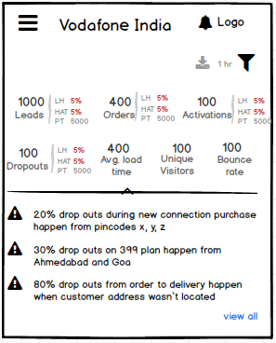
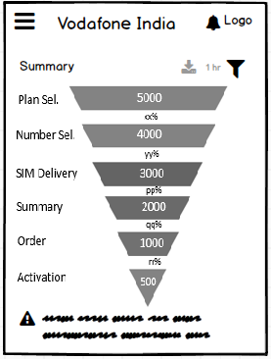
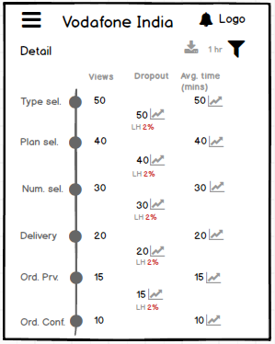
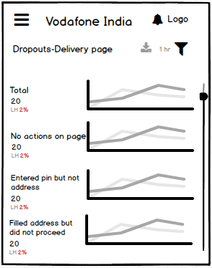
Sample journey flow dashboards

Slide 13
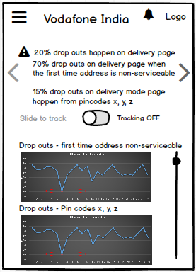
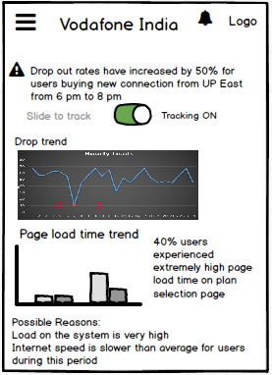
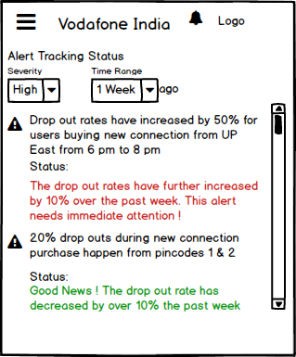
Sample journey flow dashboards
Sample dashboard for one of the alerts generated by the system

Slide 14
Order to Delivery
30% drop outs happen from pin codes 1, 2, 3
50% drop outs from Logistics Partner 1 are in pin codes 2, 4, 5
40% drop outs happen when appointment date selected for shipment is more than > 2 days from order confirmation
30% drop outs happen when users spend > 2 minutes on plan selection page and delivery mode page
90% users completing their purchase journey in <3 minutes activate their SIM cards
80% drop outs from pin codes x, y, z happen when selected appointment date is > 3 day from order confirmation (or on a working day)
80% drop outs happen when customer address wasn’t located

Slide 15
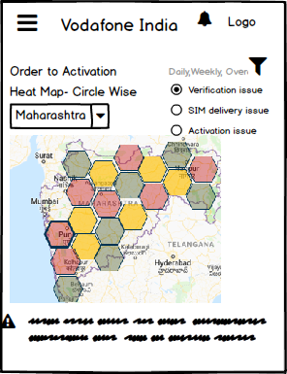
Order to Activation drop outs
Order to Activation drop outs
City wise and PIN wise drop out issues
Root cause for drop outs in Order->Delivery and Delivery -> Activation
Correlation analytics for activation within 2 days vs Rest
Prioritizing STP orders (P1,P2,P3 etc) for delivery through intent score and time taken for STP.
Fulfilment Partner Performance Analytics
Replicating the best practices of partners showing high conversions
Copyright © 2018 Sterlite Tech.
15

Slide 16
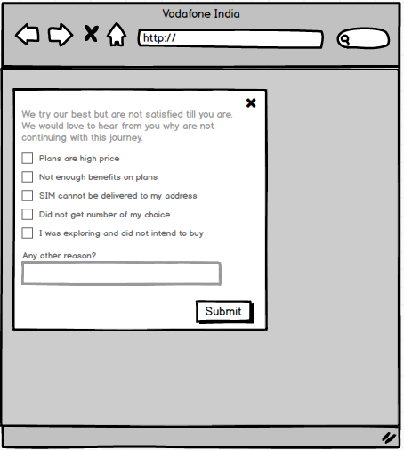
Gather customer feedback
Take customer feedback when they drop out
Use to understand “why” better
Update attributes as we learn more
Gather customer experience on order placement

Slide 17
What next & asks

Slide 18
What next and asks
Points to close
Information architecture for the drop analytics dashboard and customer feedback
Leverage Google analytics or Adobe analytics
Expose APIs from Adobe analytics in near real time
Leverage google analytics (with license)
DCCM team
Send necessary data to Google / Adobe
Customer feedback collection
Intellza
Drop out analytics dashboard
Define UX for dashboard and finalize
Mobile App

